Slide 1

JETSON TK1
3/25/2014

Slide 2
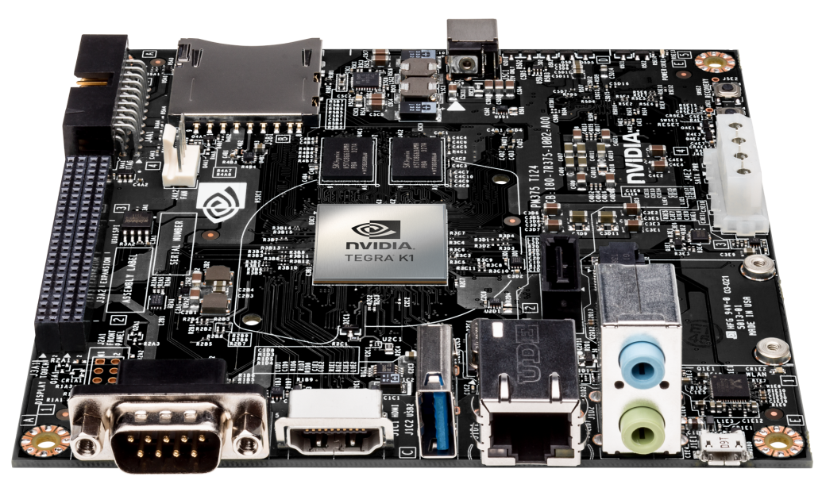
JETSON TK1
THE WORLD’S 1st EMBEDDED SUPERCOMPUTER
Tegra K1 Development Kit
CUDA
VisionWorks
Complete development tool suite
Available now

Slide 3
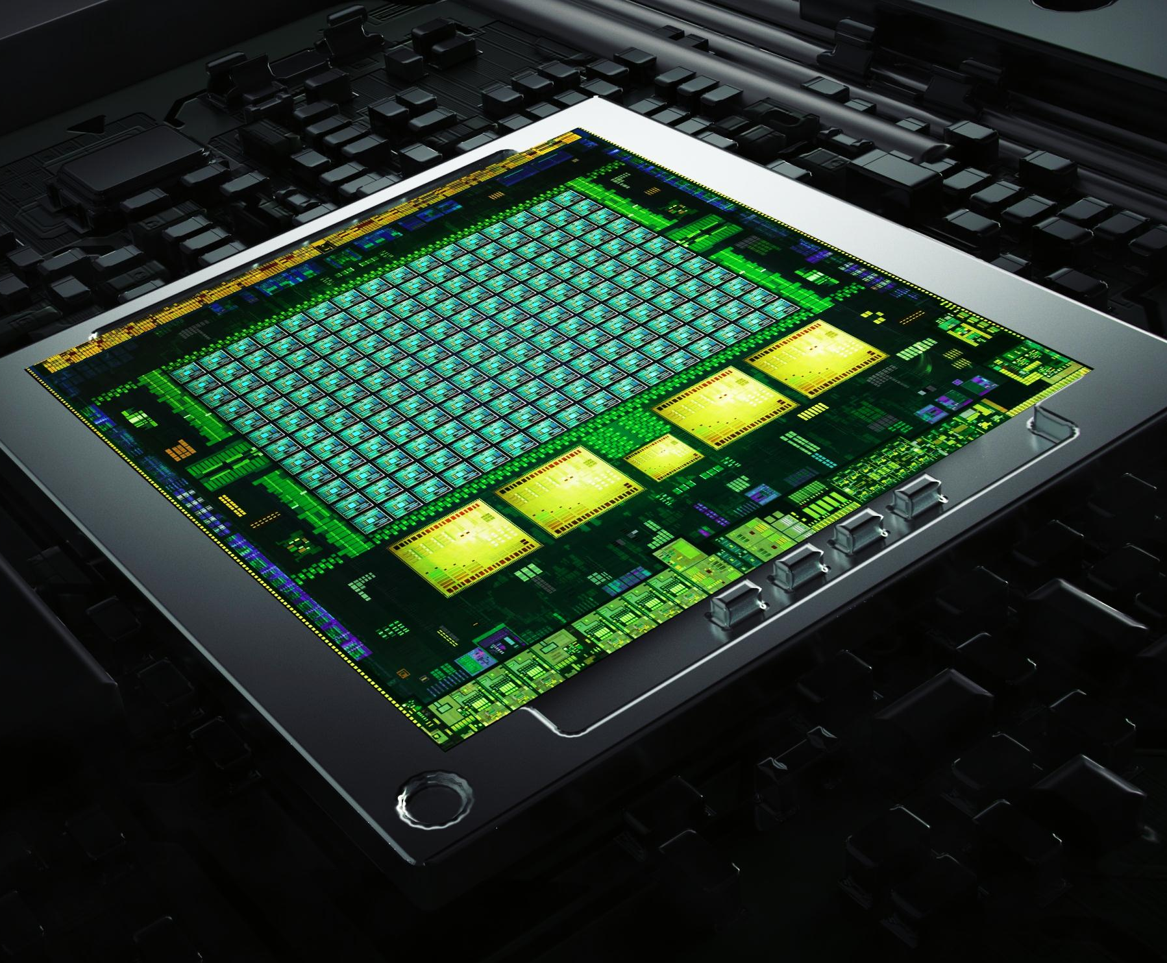
TEGRA K1
IMPOSSIBLY ADVANCED
NVIDIA Kepler Architecture
4-Plus-1 Quad-Core A15
192 NVIDIA CUDA Cores
Over 300 GFLOPS
5 Watts
Notes:
Introduced at CES 2014, Tegra K1, a 192-core super chip, brings the heart of GeForce and the soul of Tesla to mobile.
It’s based on the Kepler architecture, which powers the world’s fastest GPU, GeForce GTX 780 Ti, as well as the Titan supercomputer at Oak Ridge National Labs.
With 192 fully programmable processor cores, Tegra K1 bridges the gap for developers, who can now build next-gen games and apps that will run on any device.

Slide 4
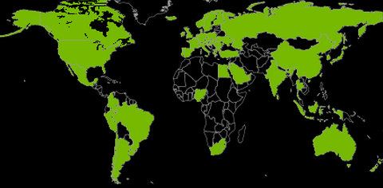
CUDA : World’s Most Pervasive Parallel Programming Platform
Institutions with
CUDA Developers
738 University Courses
In 62 Countries
8,000
2,200,000
Toolkit Downloads
506,000,000
GPUs Shipped
Notes:
395M CUDA GPUS: GPUs shipped as of 7/1/2012

Slide 5
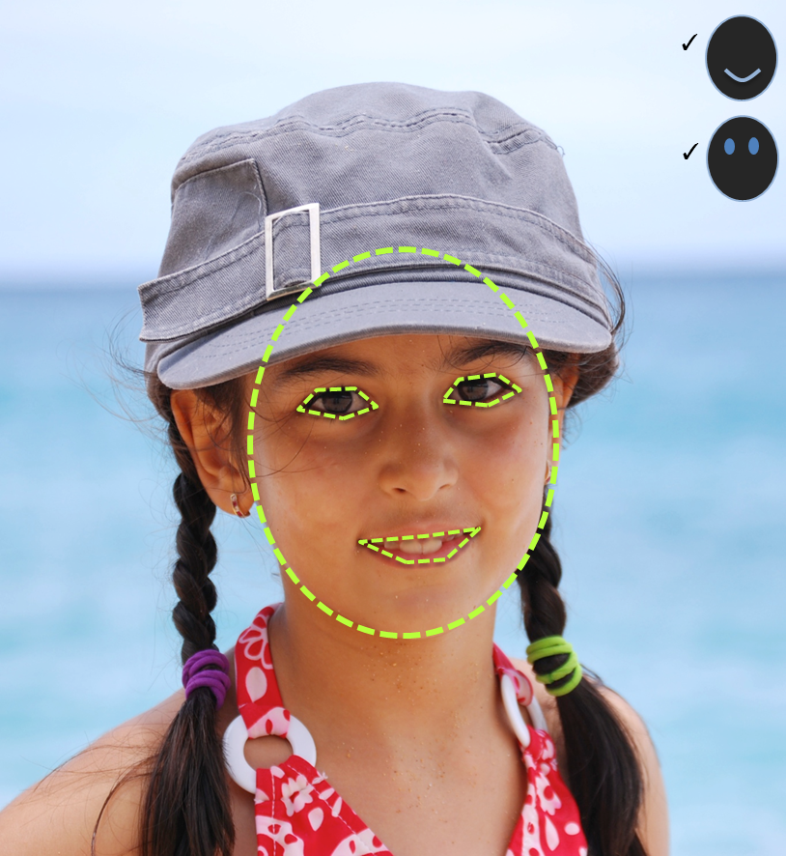
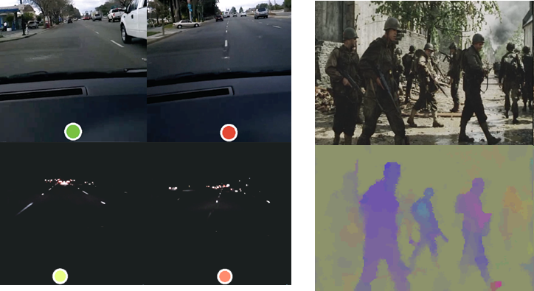
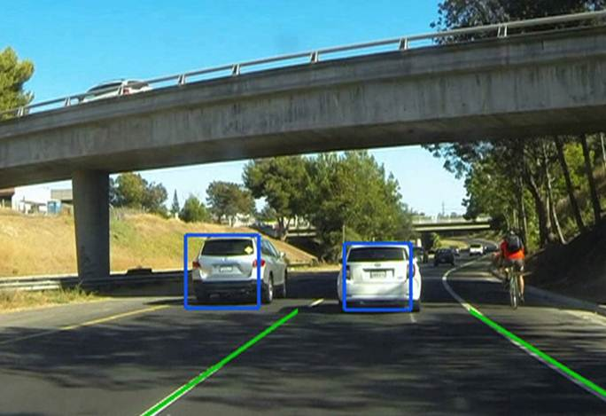

VISIONWORKS
COMPUTER VISION TOOLKIT
SDK for CV and Image Processing
Optimized for CUDA-enabled GPUs and SOCs
Example CV pipelines with source
Open and extensible architecture
Jetson TK1 compatibility out-of-the-box
VisionWorks
CUDA
OS

Slide 6
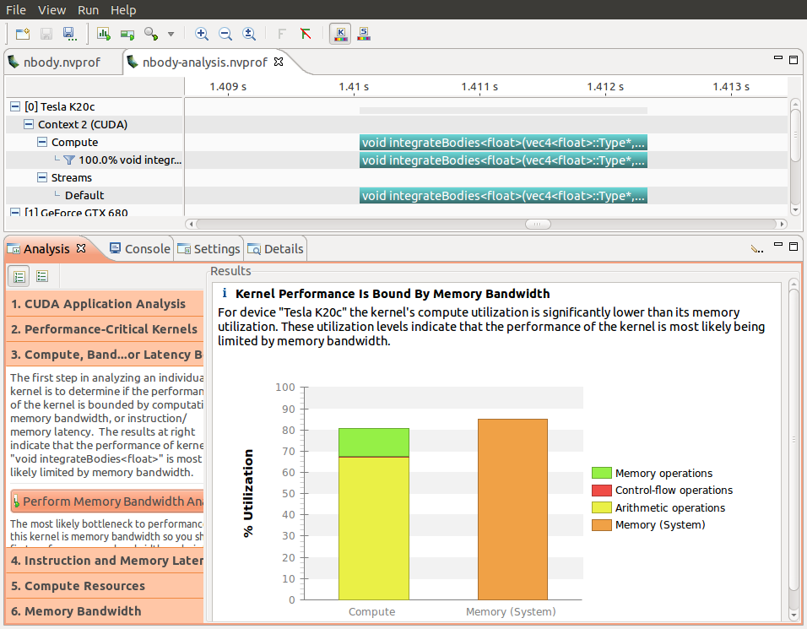
RICH DEVELOPMENT ENVIRONMENT
Nsight Eclipse Edition IDE
NVIDIA Visual Profiler
Native compiler, debugger, profiler
CUDA-enabled libraries (cuFFT, cuBLAS, cuSparse, etc)

Slide 7
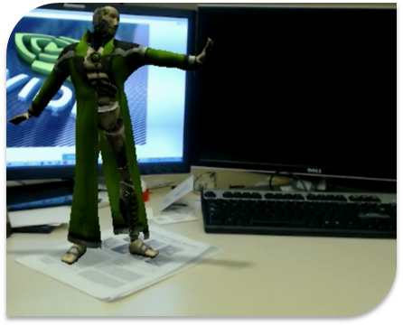
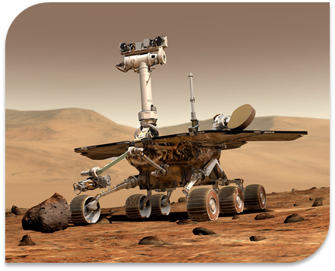
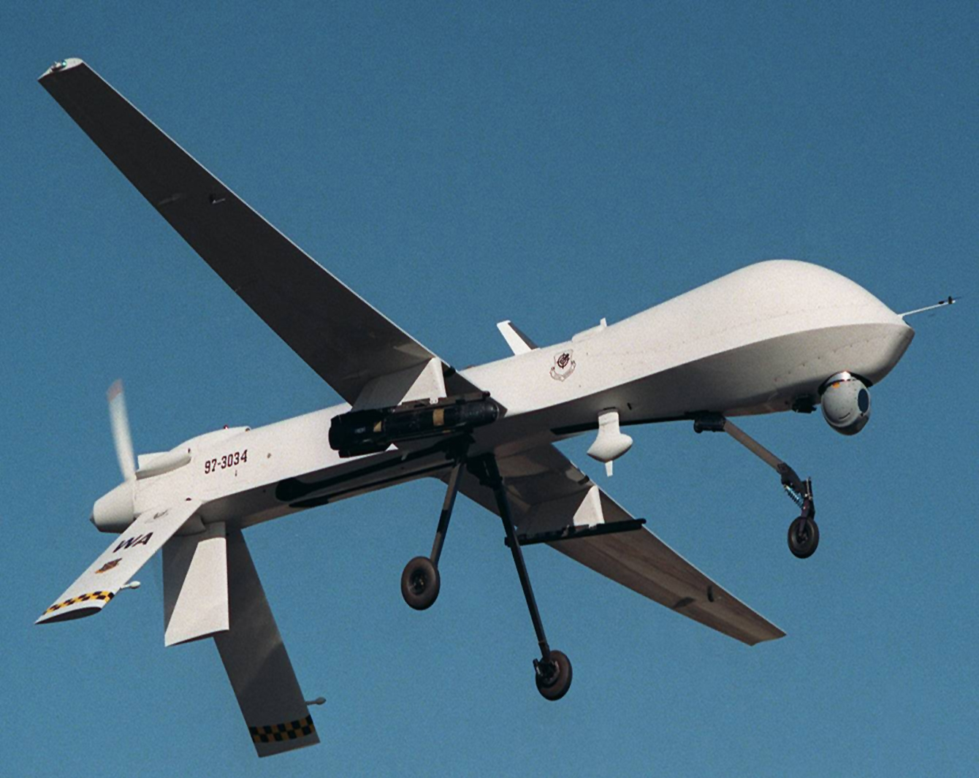
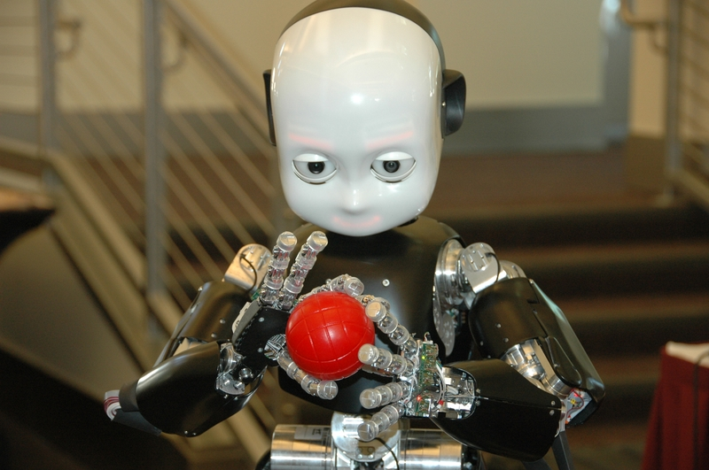
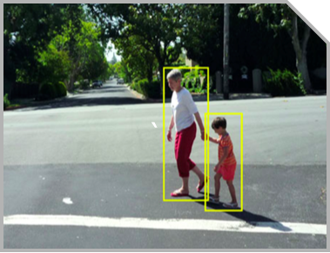
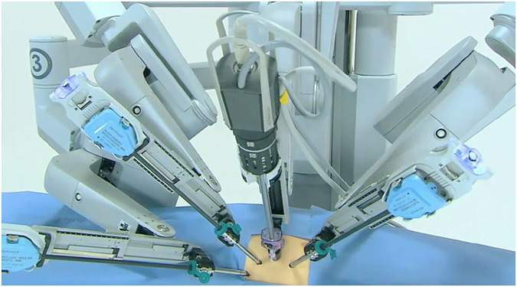
JETSON TK1: UNLOCKING NEW APPLICATIONS
Computer Vision
Robotics
Automotive
Medicine
Defense

Slide 8
JETSON TK1 BLOCK DIAGRAM
USB 2.0 micro B
Tegra K1
SOC
HDMI
USB 3.0
A
SATA
A15
GK20A
192 CUDA Cores
A15
Mini PCIe x1
A15
ALC5639 Audio Codec
Headphone Out
A15
GigE
RTL8111GS PEX - GigE
Arm7
MIC In
ISP
Audio
HD Video
JTAG
SD/MMC
2 GB
DDR3L
16 GB eMMC
Expansion Port (DP/LVDS, Touch SPI, I2C, CSI x1, CSI x4, GPIO 6:0)
AS3722
PMIC

Slide 9


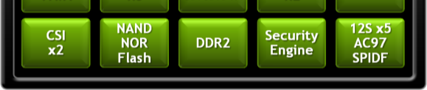
Tegra K1
28 nm HPM
23x23mm, 0.7mm pitch
HS-FCBGA
Quad Cortex-A15
4x Cores (1+ GHz)
NEON SIMD
2 MB L2 (Shared)
ARM Trust Zone
Shadow LP C-A15 CPU
ARM7
HD Video Processor 1080p24/30 Video Decode
1080p24/30 Video Encode
H.264 | MPEG4 | VC1 | MPEG2
VP8
SATA2 x1
USB 2.0 x3
Image Processor 25MP Sensor Support
ISP 1080p60
Enhanced JPEG Engine
Audio
Processor
Kepler GeForce® GPU w/CUDA
^{OpenGL-ES nextgen}
^{192 Stream} ^{Processors}
^{2D Graphics/Scaling}
PCIe* G2
x4 + x1
USB 3.0* x2
UART x4
I2C x5
SPI x4
SDIO/MMC x4
Display x2
HDMI
eDP/LVDS
CSI x4 + x4
NOR Flash
DDR3 Ctlr
64b
800+ MHz
Security Engine
DAP x5
(1²S/TDM)

Slide 10

“Tegra K1 can change what’s possible in the rugged and industrial embedded market. We expect to be able to offer solutions in the sub-10 watt space that previously consumed 100 watts or more.”
Simon Collins, Product Manager
GE Intelligent Platforms

Slide 11

“Having the level of performance and energy efficiency Jetson TK1 offers can potentially support the development of robots with real-time object recognition and compelling autonomous navigation capabilities”
Chris Jones, Director of Strategic Technology Development
iRobot Corporation

Slide 12






JETSON TK1
$192
PRE-ORDER NOW

